Slide 1
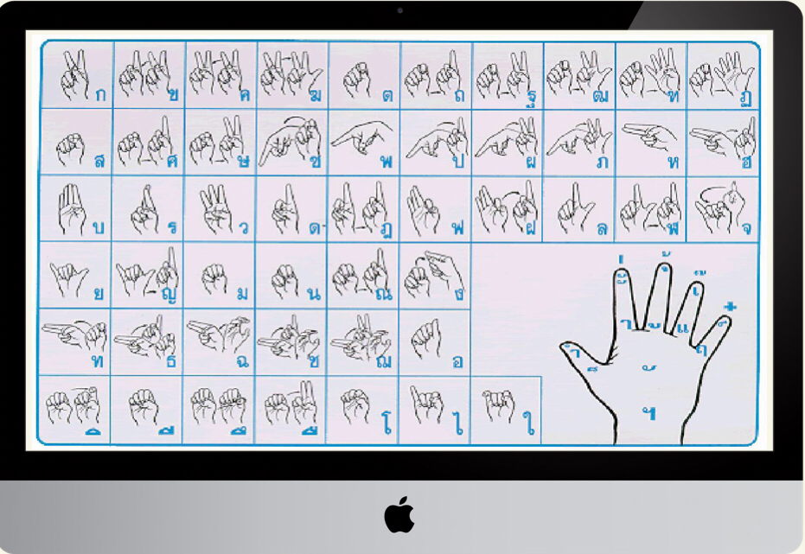
Thai Sign Language Recognition
Members List:
Krit Chayaniyayodhin 60130500207
Jullapol Satienpisarn 60130500208
Natkjorn Trakusangpaisarn 60130500210
Nipat Phattarakijtham 60130500216
Kittichok Techayanyong 60130500241

Slide 2
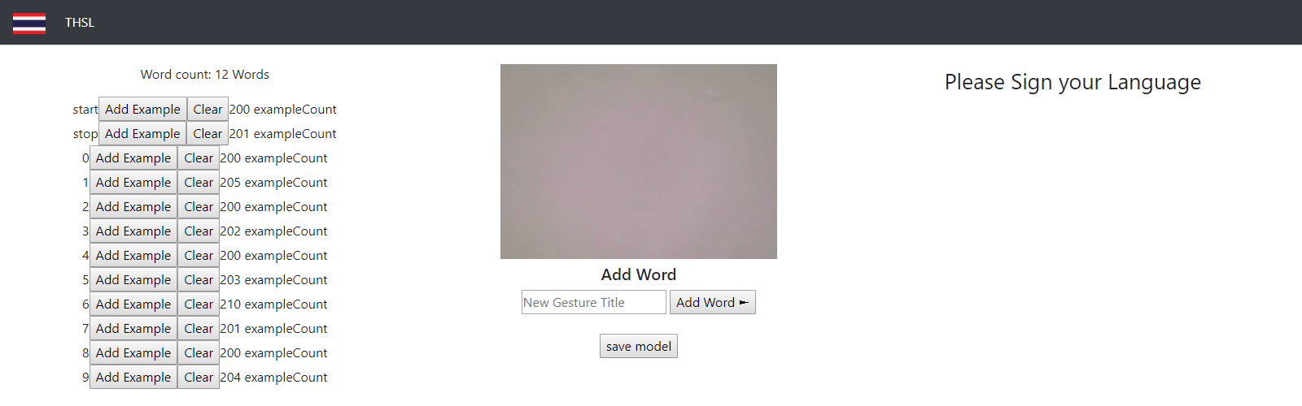
WHAT IS OUR SYSTEM?
Web based application for Thai sign language recognition

Slide 3
FEATURES
Real time image recognition
Word concatenation
Live training (adding examples to model)
Text to speech
Save model

Slide 4
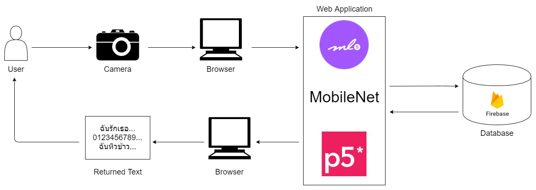
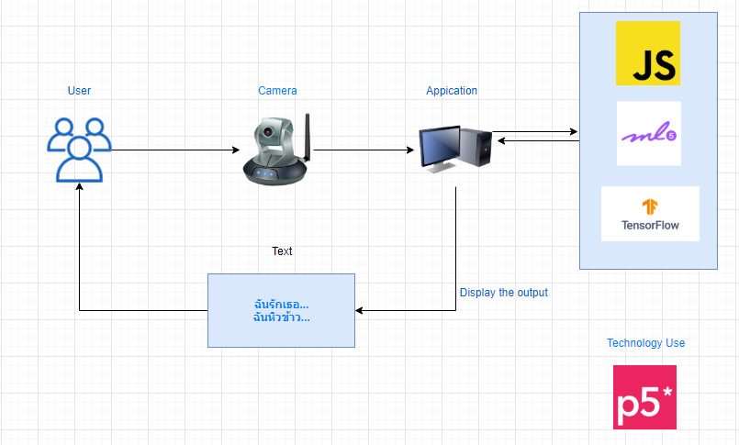
System Architecture Diagram

Slide 5
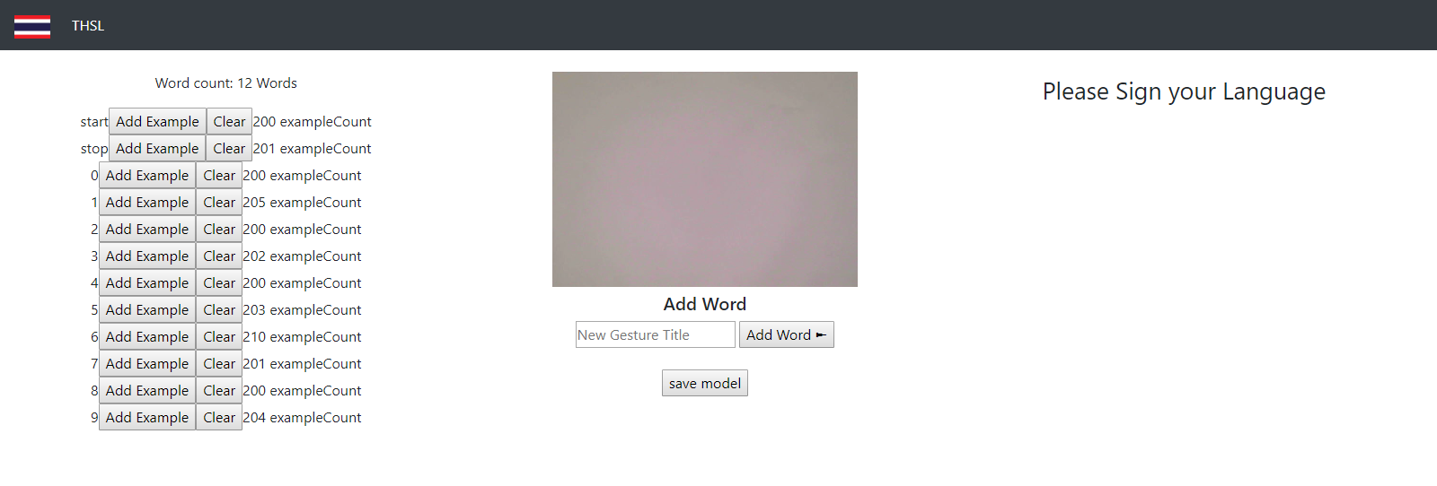
PROJECT GUI (Overview)

Slide 6
PROJECT GUI (Training)
Camera
Words available
for detecting and training
Add word for Training
Add Example into KNN-classifier

Slide 7
PROJECT GUI (Classifying)
Webcam sends image to classifier
Keeps classified text that have over 90% confidence

Slide 8
COMPONENT DETAIL

Slide 10
Future Suggestions
Use a neural network model to improve accuracy
GUI for training should be separate from recognizing
Camera window should be bigger for user experience
Should show current predictions confidence
Training should have a window that displays trained images
Train the model offline then load the model to predict
Increase the size of dataset

Slide 11
Reference & More Information
Is Sign Language International?. (2019).
Retrieved from http://www.signwriting.org/about/
questions/quest0001.html
kapook.com. (2019). ภาษามือเบื้องต้น 20 ท่า สำหรับใช้ในชีวิตประจำว Retrieved from https://hilight.kapook.com/view/85839 Making Amazon Alexa respond to Sign Language using AI. (2019). Retrieved from https://www.youtube.com/watch?v=
kS53y6GWm0w ml5.js: Transfer Learning with Feature Extractor. (2018). Retrieved from https://www.youtube.com/watch?v=
kRpZ5OqUY6Y

